Slide 1
G-CARE
A Genuine friend is a real friend you can trust.

Slide 2
Problem Statement
Vision
To get reliable and trust worthy medical help anytime for whom you care.
Mission
Onboard 100 hospitals and 10000 users to help them have easy access to health care.

Slide 3

USER PERSONAS

Slide 4
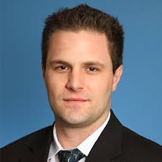
“I want to be at peace knowing my parents are safe, and in good hands.”
Pain Points
Worries about parents health conditions
Guilt feeling of not paying attentions towards his parents
Busy with work and not able to concentrate in both area
Due to transit between cities he has lost time and extra money at the time of medical emergency
Motivation
Finding an easier and reliable way to monitor families health care/needs
Seeking help from friends and/or neighbors to watch over parents
Making personal time to talk to parent(s) and visit them will help him remove the guilt factor
John Doe
29, Male
Sales Representative with 7yr Experience
Married and lives in Boston with his family

Slide 5
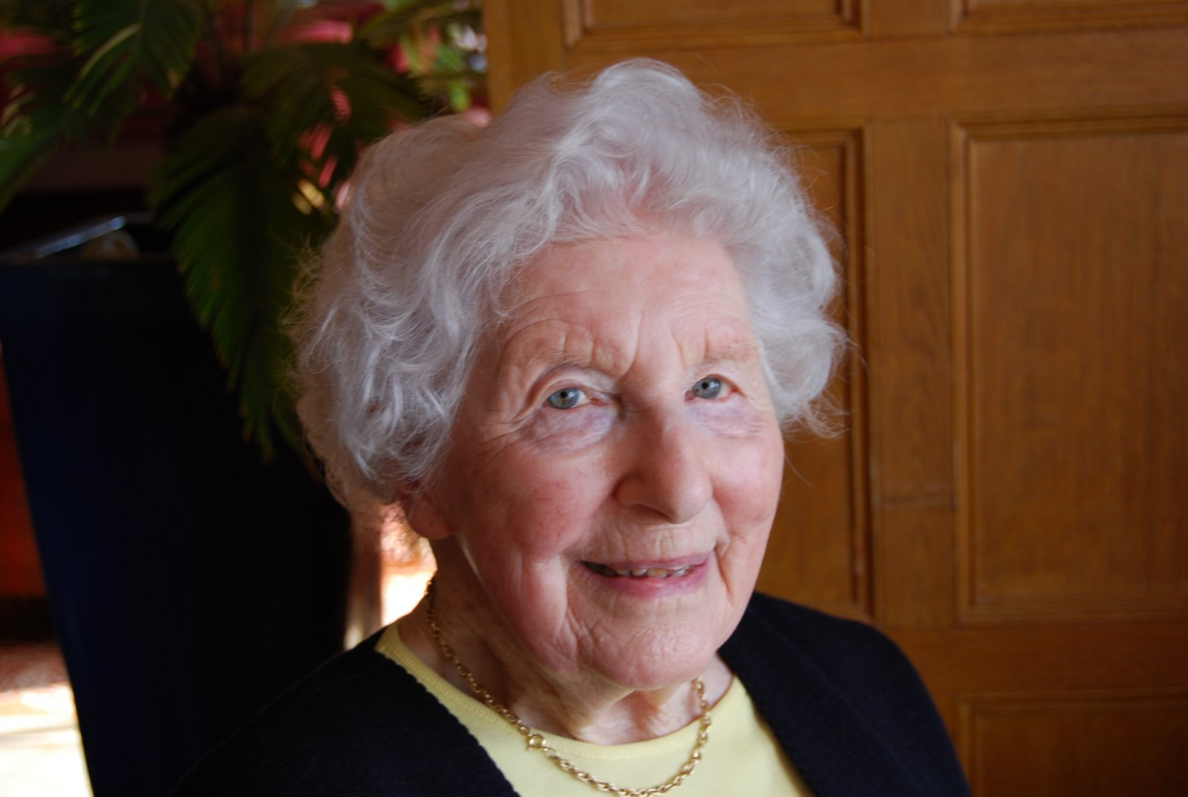
“In medical emergency, I wish it was more convenient to inform family and travel to the hospital by myself.”
Pain Points
Usually forgets to take medications
Family does not lives near by so no one to call in emergency
No one to take her to hospital as and when required
Has got insurance but doesn’t knows about the terms and procedures
Motivation
Health conscious and do morning walks and take proper diet
Reminders for taking medications
Emergency contacts are handy and respond as and when needed
Got all the personal medical records maintained with her and no need to keep junk papers will help her with insurance
Kobbie Morgan
71, Female
Retired school teacher
Lives in Chicago (congested city)

Slide 6
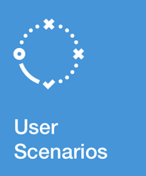
USER SCENARIOS

Slide 7
John is a sales representative who is always busy with work and he has to travel a lot. His parents live in another state and unfortunately one afternoon his mother had an accident. Because he was on a business trip, he was not able to attend his mother’s call. Finally, he got to know she was in the emergency room in a nearby general hospital. He had to reach out to other people to find out about her condition.
He is feeling guilty and helpless after this incident because of the work and distance, he was being there for taking health care of his parents.
User Tasks
Receive an emergency alert by any means
Respond to the alert with trust
Call / Notify others regarding the condition and help
Know which hospital parent has been taken to or know the whereabouts of the parent

Slide 8
Cobie is independent widow who lives in Chicago alone. One evening while working in the kitchen, she suffered with slip disc and unable to get up. She was in excruciating pain but managed to reach a phone to call the ambulance. While waiting for the ambulance, she called her son but could not get through. She then called her neighbor to inform him of the accident.
Due to the traffic, it took a longer than usual to reach to the hospital. She was rushed to the emergency room and treated. Later, attending nurse was asking her about her medical history and other insurance details but she didn’t know about all this details.
User Tasks
Send an alert to multiple people (By all means) and/or nearest hospital
Get transportation help ASAP
Notification to all attached members by all means available
Have proper medical history and insurance details handy.

Slide 9
AFFINITY MAPPING

Slide 10
AFFINITY MAPPING
Emergency Situation
Fast and quick response
Get help
108
Alert with(out) phone
Pulse rate
Connect to ambulance
Connect with family /Neighbour’s / Other contacts
Connect with doctors/hospitals
Help assistant
Health monitoring
Medical kit
Precautionary guidelines
Transportation
Speed dial
Ambulance
Location
Mapping (GPS)
Luxury transportation
Traffic management
Transport management System
24/7 facility
At the Hospital
History / medical report
Status updates and alerts (to family members)
Visiting hours

Slide 11
AFFINITY MAPPING
Health Insurance
Policies benefits
Less paperwork
Document Verification
Tie up with NGO
Payment System
Cash / Cashless
Paytm
Instalments
Online Banking
Services / Post Hospitalization
Personal nurse care
Diet / Food plan
Buy Medicines Online
Booking Appointments
Regular Health check-up
Counselling
Billing Records (for taxes)
Account
Bills
Budget
Maintain History

Slide 12
FEATURES

Slide 13
FEATURES
Must have
Alert system (with or without phone)
Update health status
Reports / records
Commute System
Hospital registration info
Quick access to emergency contact numbers (ambulance, fire, police, family)
Locate nearby hospital
Access to good hospital care (doctors, nurses)
Knowledge of what to do in an emergency (precautionary procedure)
Easy and hassle-free payments
Good to have
Appointment booking
Tie up with Health insurance
Medication Management
Specialty Hospitals (for specific treatment or disease)
Delight factor
Personal nurse care
Regular Health Check-up
Diet/Nutrition plan
Wheel chair facility
Online Medicines

Slide 14
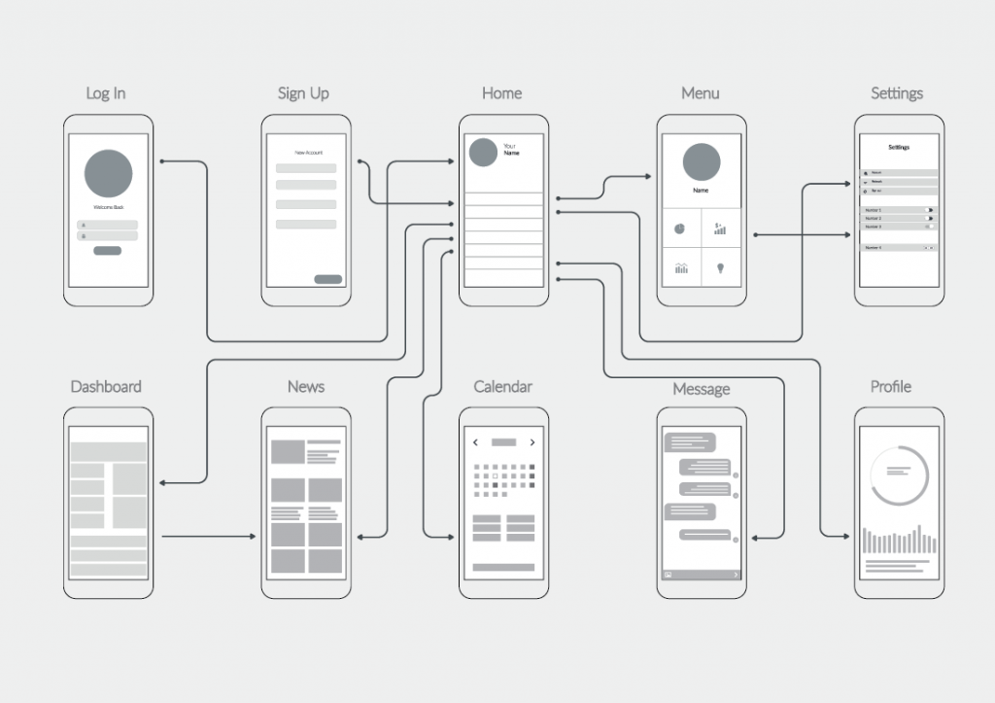
WIRE FRAMING AND PROTOTYPING
Click here for the demo

Slide 15
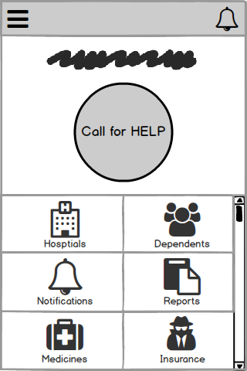
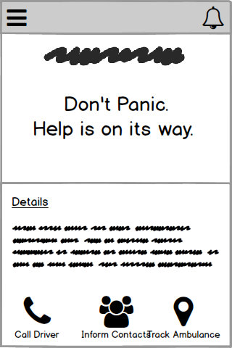
Calling for Help

Slide 16
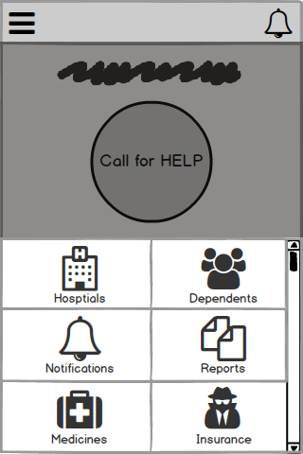
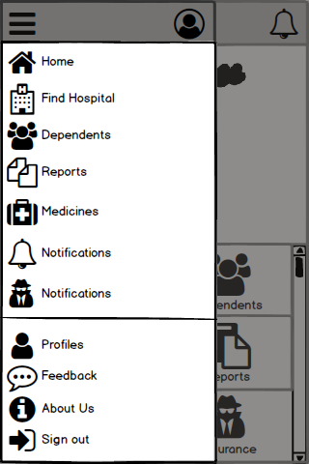
Menu Selections

Slide 17
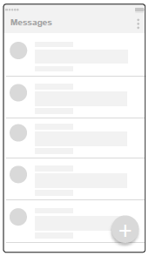
Alerts and more

Slide 18
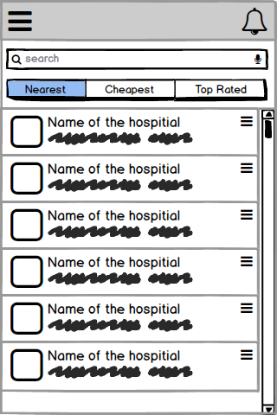
Find Hospital

